Slide 1

TEAM TECH TITAN

Slide 2
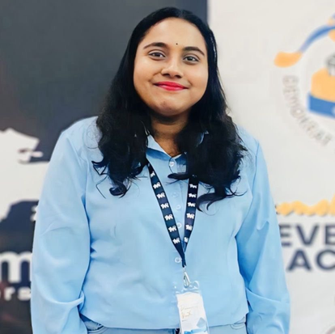

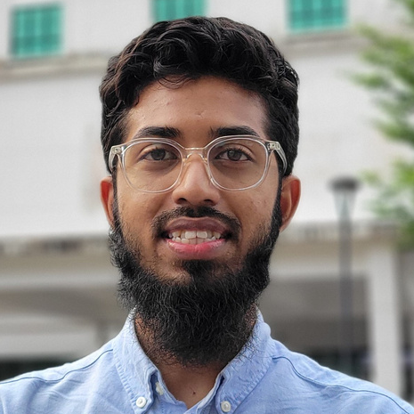
THE TEAM
Daniel Tri Hendarto Tanra
Lallithambigai Renugopal
Saad Ahmed Pathan
Team Member
Team Member
Team Captain
Computer Science,
Universiti Technologi Malaysia
Computer Science,
Universiti Malaya
Management Information Systems, AIMST University

Slide 3
PROBLEM STATEMENT
Charity fund systems lack transparency, efficiency, and end-to-end tracking.
Outdated donation systems reduce impact and limit donor engagement.

Slide 4
CHALLENGES FACED BY DONATORS
Trust & Transparency Issues:
Uncertainty whether donations are delivered or misused for personal gain, leading to fear of scams.
Lack of Progress Visibility:
Donators cannot track the impact of their contributions or see tangible outcomes.
Limited Engagement:
Inability to interact with recipients makes the experience feel impersonal and disconnected.

Slide 5
CHALLENGES FACED BY DONATORS
Trust & Transparency Issues:
Uncertainty whether donations are delivered or misused for personal gain, leading to fear of scams.
Lack of Progress Visibility:
Donators cannot track the impact of their contributions or see tangible outcomes.
Limited Engagement:
Inability to interact with recipients makes the experience feel impersonal and disconnected.

Slide 6
PROPOSED SOLUTION
A blockchain-based web application that enables individuals practice charity and donation digitally while it ensures:
TRANSPARENT DONATION TRACKING
AUTOMATES FUND DISTRIBUTION
ENHANCES FINANCIAL INCLUSION

Slide 7
NEW FEATURE
Track Your Impact:
Donators can see exactly how their money is used — from start to finish.
Connect with Recipients:
Interact with the people, projects, or communities you support.
Optional Volunteering:
Join on-site during delivery to see the impact firsthand.

Slide 8
INCLUSIVE (SHARIA’S)
Zakat (Obligatory Almsgiving)
2.5% of wealth (cash, gold, silver, investments, trade goods),
Agricultural produce, livestock (under certain conditions)
Sadaqah (Voluntary Charity)
Money, Food, Clothes
Waqf (Endowment)
Land, Buildings, Educational institutions, Wells or mosques
Infaq (Spending in the Way of Allah)
Wealth or time (Volunteer) for causes like education, dawah, disaster relief

Slide 9
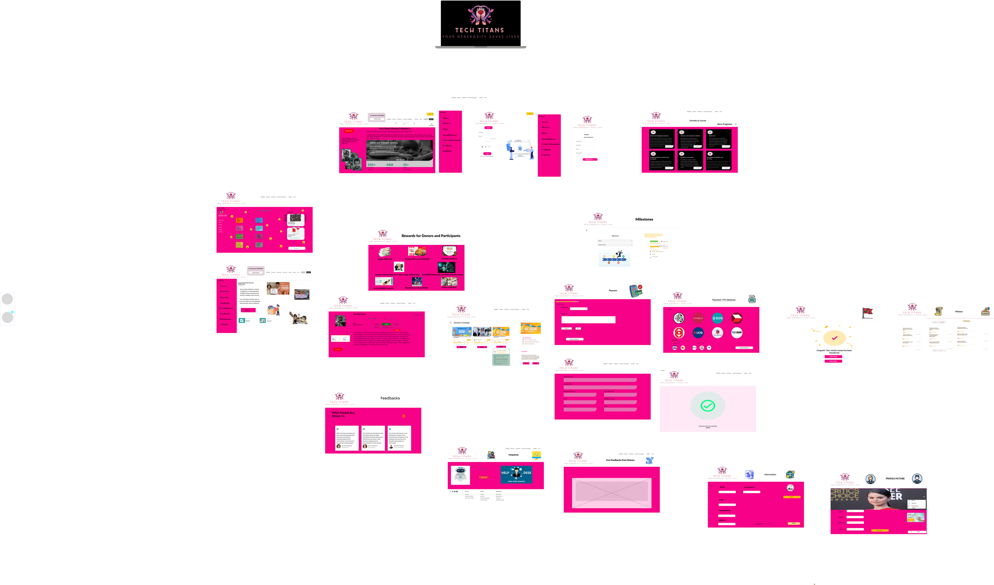
PROTOTYPE

Slide 10

PROTOTYPE
LINK TO VIEW PROTOTYPE
HTTPS://WWW.FIGMA.COM/DESIGN/APQ3BZ2BHKZRBZBYNUG1TH/TECH-TITANS?NODE-ID=2-2&T=TQY1MVFX9TYOTJOX-1

Slide 11














REQUIRED TECH STACK
FRONTEND
BACKEND
CORE

Slide 12

BLOCKCHAIN AND DEFI OPERATION
TO PROVIDE TRANSPARENT,
END-TO-END, TRANSACTION RECORDS
TO AUTOMATE FAIR AND CONDITION-BASED RELEASE OF FUNDS
FOR POOLED FUND MANAGEMENT AND DECENTRALIZED GOVERNANCE
(Smart Contracts)
(Donation Tracking)
(DeFi Pools)

Slide 13
BUSINESS VALUE

Slide 14
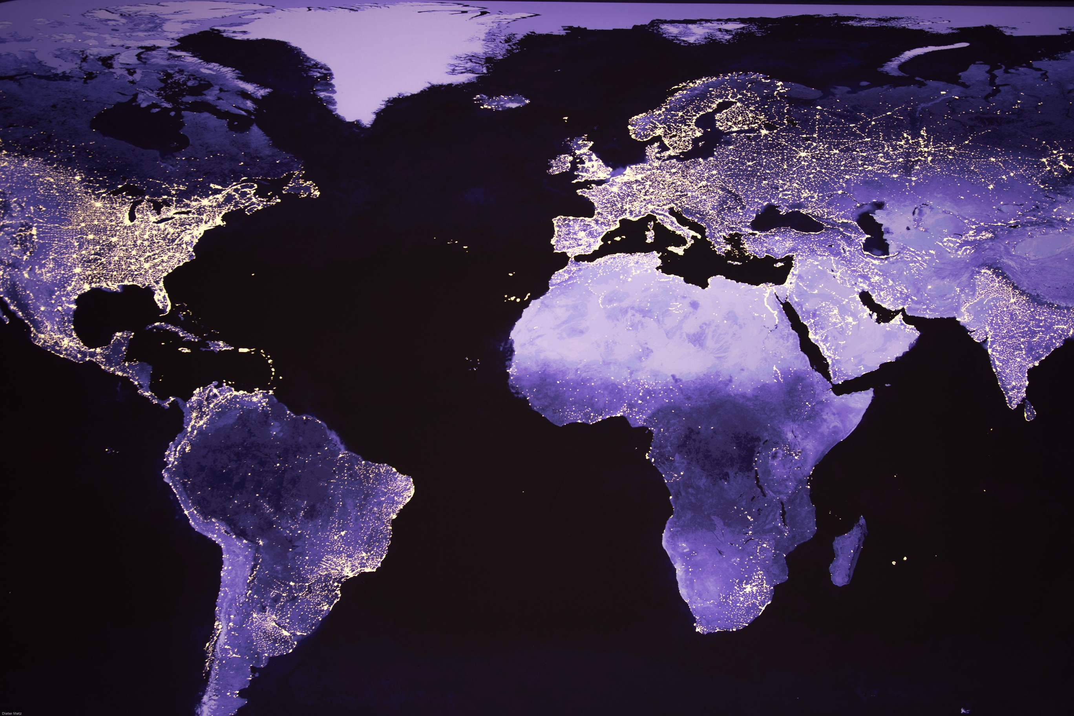
GLOBAL VALUE OF ZAKAT & SADAQAH
$1 TRILLION+
WHILE CHARITY AND DONATION HAS $353.21 BILLION VALUE IN 2025
SOURCE: UNHCR, UNDP & INTERNATIONAL CENTRE FOR TAX AND DEVELOPMENT

Slide 15

AS FOR 2024, IT HAS OVER 150 MILLION DONORS
EVERY 8 SECONDS GOFUNDME STARTS A NEW CAMPAIGN
OVER $30 BILLION HAS BEEN RAISED ON THE PLATFORM
AVERAGE RATE
DONORS CONTRIBUTED
PER SECOND WAS $40

Slide 16
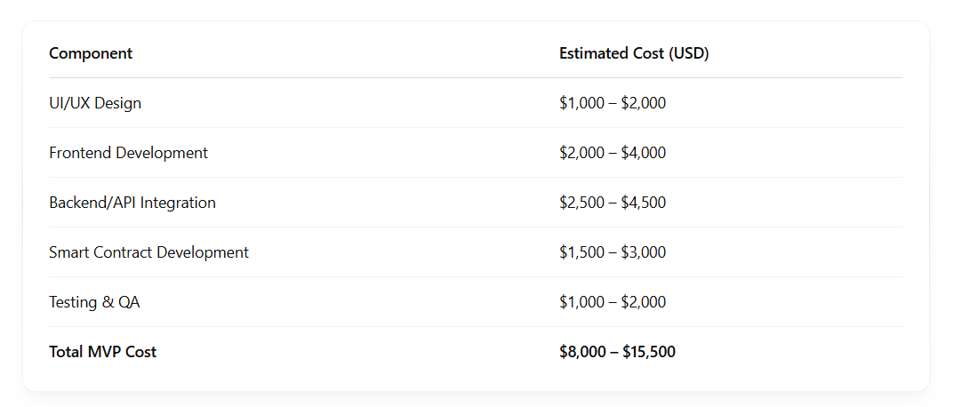
FINANCIAL PROJECTIONS

Slide 17
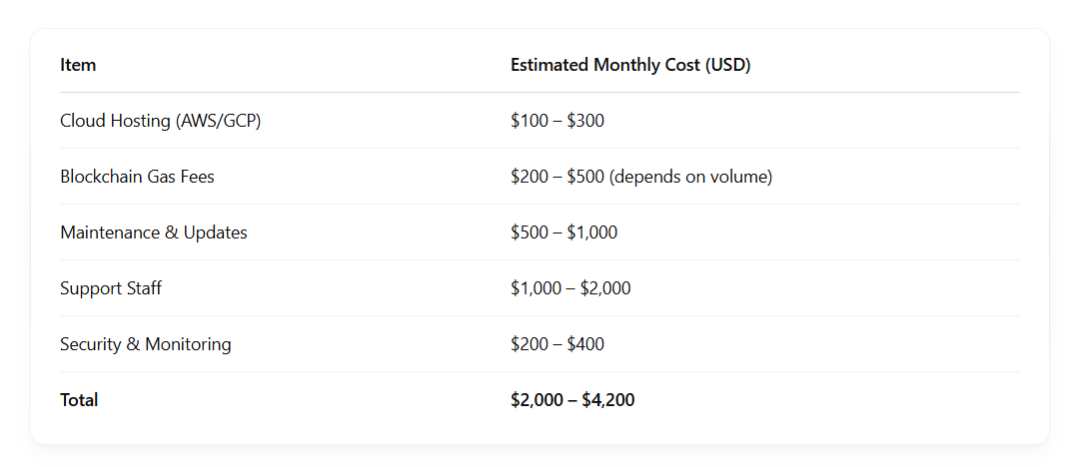
SCALING & OPERATIONAL COST (MONTHLY)
Note: Costs will increase with user base and transaction volume.

Slide 18
THANK YOU

Slide 19
Q&A

